Slide 1
Post Election Audits
In Maryland
Presented by Nikki Baines Charlson, Maryland State Board of Elections
South Carolina’s 2018 Election Security and Technology Workshop – August 7, 2018
Notes:
Good morning. I am very happy to be here today to speak with you about the post election audits that we conducted during the 2016 election cycle.

Slide 2
Background
We used a new voting system statewide in 2016 - a paper-based system.
This system captures and stores images of all ballots cast in the election.
This meant that we could audit the election results at a ballot level and didn’t have to touch the voted ballots.
We piloted 3 audit methods after the 2016 Primary Election

Slide 3
What is an audit?
A comparison of 2 independently produced results that are derived from the same data.
Why audit election results?
To protect and ensure the integrity of the election process
To verify and confirm the accuracy of the voting systems reported results
To ensure that the voting system is accurately tabulating ballots
To ensure that the winners of each contest are called correctly
To increase confidence in the election results

Slide 4
What audit methods did we pilot?
Ballot level audit applying risk limiting audit (RLA) principles – The sample size of ballot images was determined by the margin of victory in the contest and the selected ballot images were tabulated manually.
Fixed percentage audit – 100% of all ballot images in 1% of randomly chosen precincts were manually tabulated.
Independent Automated Software Audit – Relied solely on independent software to tabulate the ballot images.

Slide 5
Ballot Level Audit Applying RLA Principles
Needed a statistician to:
Select the contest with the smallest margin of victory
Determine the number of ballot images to review and which ballot images to review
Teams of 2 manually tallied the votes on the selected ballot images and compared the votes on ballot images against how the voting system counted that ballot.
Notes:
For the ballot level audit we…
A central feature of risk limiting audit methodology is that as the margin of victory gets smaller, the sample size gets larger.
Initial Sample Size is determined by entering in the number of ballots cast in the contest, the number of candidates in the contest, the votes that each candidate received and the risk limit percentage.
The sample size is then entered into the pseudo-random number generator along with a 20 digit seed number that is generated by rolling a 10-sided dice.
The resulting numbers are then used to identify which cast vote records and ballot images would be reviewed.
Using a pseudo-random number generator allows the sequence of numbers to be replicated by anyone using the same seed number, thereby allowing for greater transparency.

Slide 6
Fixed Percentage Audit
Needed a statistician to:
Ensure that each ballot cast had an equal chance of being selected, regardless of the precinct size.
Based on the number of votes cast by precinct, assign a range for each precinct in each county.
Used a ten-sided dice to select the precinct being audited.
Teams of 2 manually tallied the votes on the selected ballot images and compared the manually tallied results against the voting system’s precinct results.
Notes:
For the fixed percentage audit we again…
The range calculated by dividing the votes cast in the precinct by the total votes in the county. The range for precinct 1, for example, was 0 to .05 and precinct 2 started at .06. The actual ranges had 6 digits after the decimal point.

Slide 7
Independent Automated Software Audit
Sent vendor images of voted ballots
Vendor tabulated the ballot images
Compared the vendor’s aggregated results against the voting system’s aggregated results
Sent the vendor precinct-level reports from the voting system
Vendor provided 4 different audit reports by county
Comparison of Cards Cast
Comparison of Ballots Cast by Precinct
Comparison of Votes Cast
Contest Discrepancy Threshold report
Notes:
For the Independent Automated Software Audit we sent the ballot PDFs and the voting system zero reports by precinct prior to the election.
After the election, the local election officials sent the voted ballot images to the vendor. The vendor tabulated the ballot images and provided its result reports to us. After we verified that the result reports were complete, we sent the voting system precinct results report to the vendor so that the vendor could generate the comparison and threshold reports. The 4 different audit reports that were provided were the Comparison of Cards Cast, the Comparison of Ballots Cast by Precinct, the Comparison of Votes Cast and the Contest Discrepancy Threshold report. The contest threshold report showed the absolute value of the differences between the two systems. Using the absolute value prevents positive and negative differences from cancelling each other. It also showed the total votes cast by the primary voting system, and the vote difference as a percentage. Before the audit was performed, we determined that a percentage of 0.5% or higher would trigger an additional review.
The additional review could include a manual review of voted paper ballots.

Slide 8
What did we learn? All 3 audit methods verified the accuracy of the voting system results.
Notes:
Although all three audit methods verified the accuracy of the voting systems results, we found that…

Slide 9
Ballot Level Audit Applying RLA Principles
Difficult to estimate budget and staff needed because it depends on the margin of victory
Need a statistician
Difficult to explain
Extremely difficult to implement statewide because of the highly variable number of ballot images that must be reviewed
A close margin of victory means complete manual re-tabulation of the ballot images
Human error required an additional review of the ballot images and the Cast Vote Records
Notes:
The Ballot Level Audit…

Slide 10
Fixed Percentage Audit
Difficult to estimate budget and staff needed because don’t know the size of the precinct being selected
Need a statistician
Less confident in audit results because only ballot images from a single or small number of precincts are audited
A small precinct (15 ballots) could be selected when hundreds of thousands of ballots could have been cast in that county
Human errors could require a 2nd or 3rd manual review of the ballot images
Notes:
The fixed percentage audit…

Slide 11
Independent Automated Software Audit
Re-tabulates 100% of the ballot images using tabulation software that is different than the voting system
Maximizes the use of technology in election
Requires very little resources from state and local election officials
Can be completed prior to election certification deadlines
Eliminates the subjective and error-prone human element
User friendly
Audit results and images available for public review
Notes:
The Independent automated software audit

Slide 12
What criteria did we use to select an audit method?
Maximize the technological functions of the new voting system
Minimize human error and eliminate chain of custody issues by using securely stored ballot images, rather than actual voter paper ballots
Minimize the use of valuable staff time at the local election office in the days following the election
Complete the audit prior to legally binding certification and swearing-in deadlines
Be conducted at the ballot-level
Be independent of the primary voting system

Slide 13
For all the reasons mentioned…

Slide 14
We used an independent automated software audit for the 2016 General Election. The vendor selected to perform this audit was the Clear Ballot Group. http://maryland.clearballot.com/AboutthisPortalVideo.html
Notes:
If Internet access, show portal video - http://maryland.clearballot.com/AboutthisPortalVideo.html

Slide 15
This audit confirmed the accuracy of the voting system and we discovered a lot more.

Slide 16
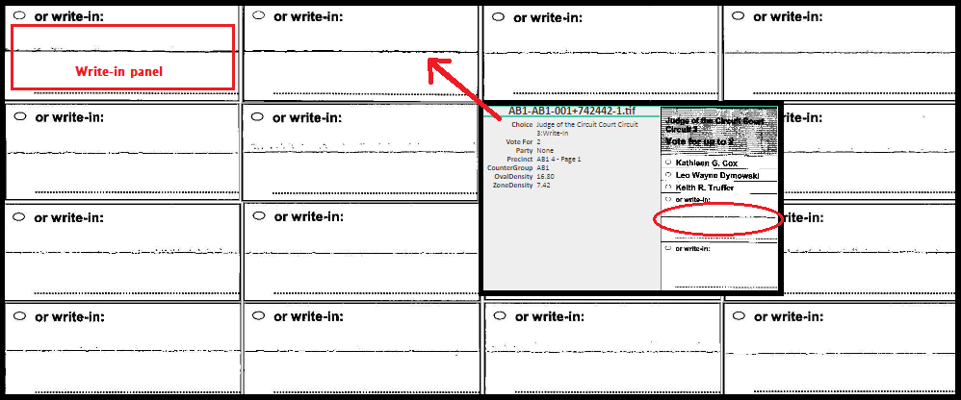
Folds through write-in area were counted as votes
Click Here
Note: Maryland tabulated write-in votes whether the oval is filled in or not
Notes:
Folds through the write-in area. In Maryland we tabulate write-in votes whether the ovals are filled in or not. In order to accomplish this, the scanner detects marks in the highlighted write-in panel and counts those marks as votes. In this case, folds, not marks, through the write in panel triggered votes. Using the audit site, we immediately noticed the line through the write-in panel. Clicking on one of the write-ins….

Slide 17
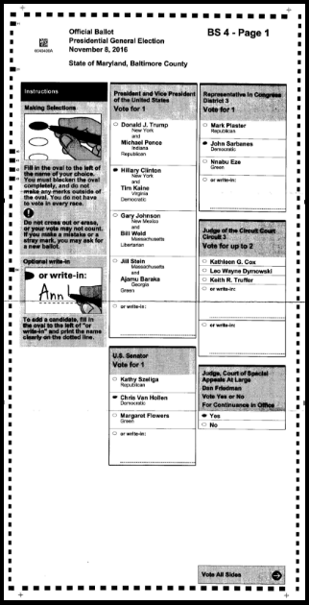
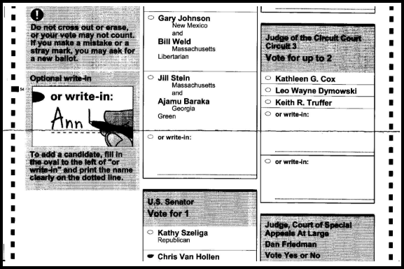
The ability to see the full ballot allowed us to see the fold clearly
This issue was identified prior to certification and was corrected
Notes:
We were able to see the entire ballot which makes the fold very obvious.
This issue was discovered and corrected prior to the certification of the election results.

Slide 18
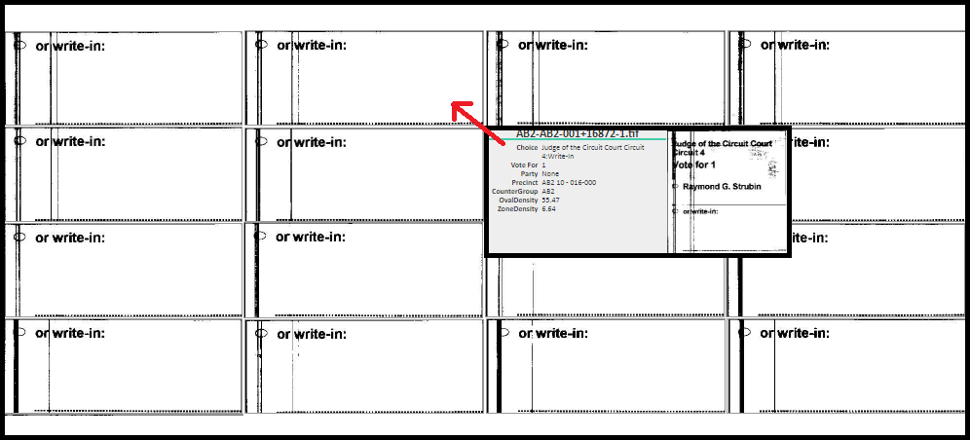
Residue and scratches on the scanner’s lens caused overvotes
Click Here
Notes:
Residue and scratches on the lens resulted in overvotes. In this case, the lines were vertical. Clicking into the write-in panel…..

Slide 19
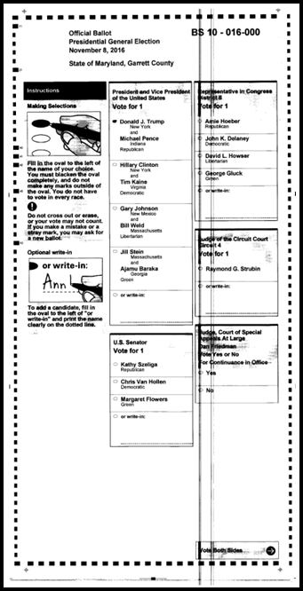
The voting system’s Cast Vote Record export showed the overvotes but without the visual representation of the ballot, this issue would have been difficult to identify
The ability to see the full ballot allowed us to see the lines clearly. This issue was identified prior to certification and was corrected.
Notes:
Opened up the full ballot image where we could see that the line went through all of the ovals in that column. After reviewing the voting systems cast vote record for this ballot (on the right), we saw that the voting system tabulated overvotes, however, without the visual representation of the ballots, this issue would be difficult to identify and resolve.
As a result of our independent software audit, this issue was discovered and corrected prior to the certification of the election results.

Slide 20
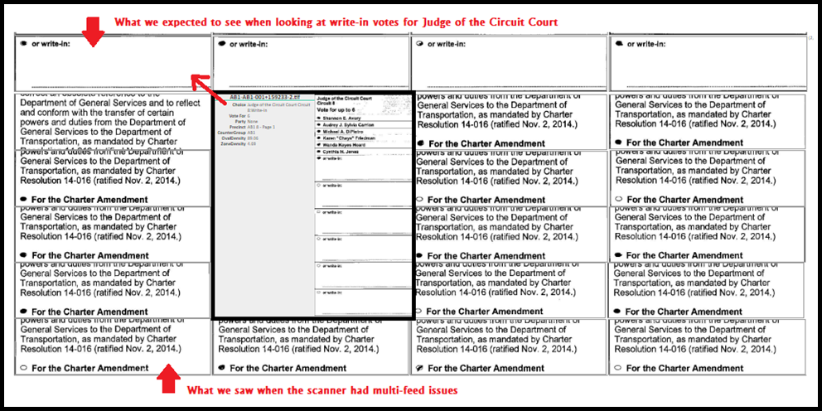
“Double Pull” issues on high speed scanners
This happened when the scanner pulled 2 ballots but scanned as 1
Notes:
Another issue we discovered were double pulls on the high speed scanners. What we expected to see were only snippets of the write-in boxes. When hovering over the expected write-in boxes, we see the contest being reviewed. In this case, we also saw ballot question text…

Slide 21
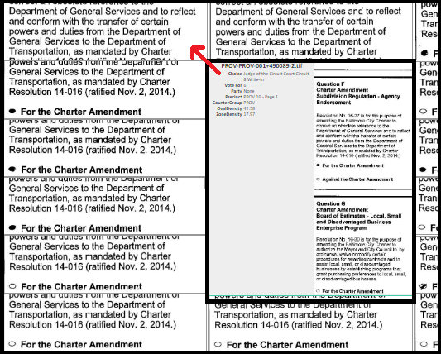
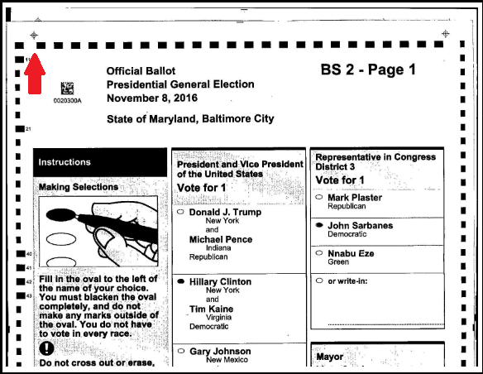
Hovering over the multi-feed ballots showed different contests than the one we expected to see
The ability to see the full ballot allowed us to see that more than one ballot was scanned
This issue was identified prior to certification and was corrected.
Notes:
When hovering over the ballot question text, we didn’t see the contest being reviewed but instead, 2 ballot questions. Clicking on the ballot question text pulled up the full ballot image where we could clearly see that 2 pages were scanned at the same time.
Again, as a result of our independent software audit, this issue was discovered and corrected prior to the certification of the election results.

Slide 22
What kinds of questions can be answered using an independent automated software audit that are challenging, if not impossible, to answer without one?

Slide 23
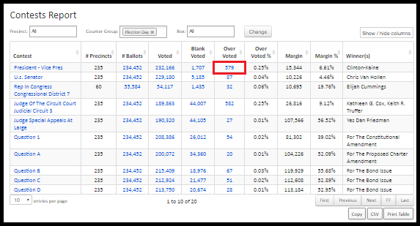
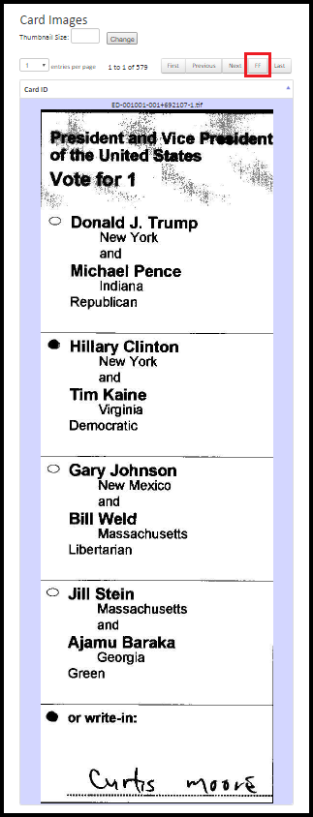
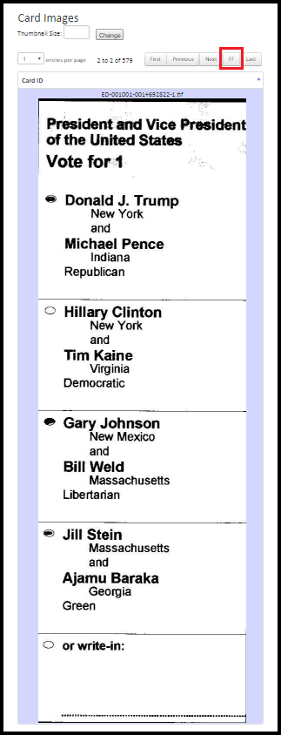
Why would a large number of voters show up and vote for more than 1 candidate for President?
After reviewing the ballot images, we determined that the reported overvotes were true overvotes.
Notes:
These are actual questions that we had to answer this past general election and we were able to answer them as a result of this audit.
The first question was - There is a large number of overvotes in the Presidential contest. Why would voters show up to the polls and vote for more than one candidate for President?
In order to answer this question, we used the contest visualization tool. Once logged into the audit site, we clicked the link for overvotes next to the Presidential contest. By doing so, we were able to review images of all overvoted Presidential contests and confirmed that they were in fact overvotes.

Slide 24
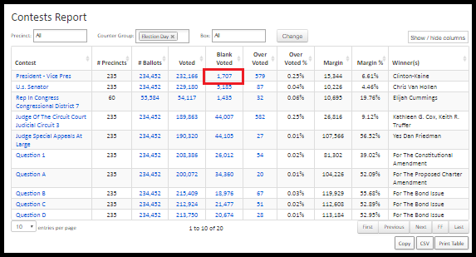
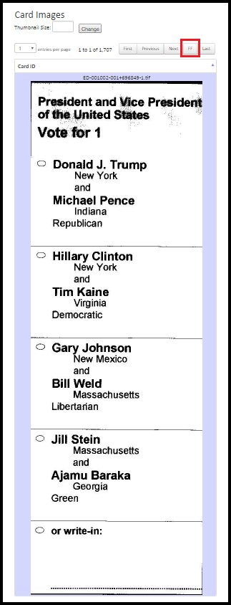
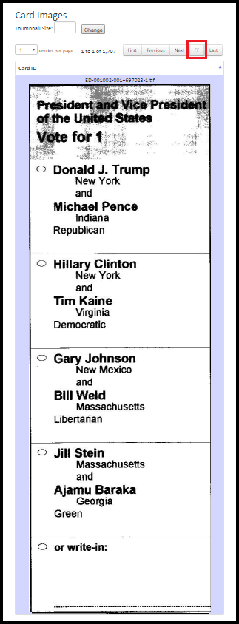
Why would a large number of voters show up and not vote for any Presidential candidate?
After reviewing the ballot images, we determined that the undervotes were true undervotes.
Notes:
The next question was, there is a large number of undervotes in the Presidential contest. Why would voters show up to the polls and not vote for any Presidential candidate? For this we reviewed the blank contests and again we were able to confirm that these were undervotes or the voter made a mark somewhere other than in the oval.
There was a lot of variety.

Slide 25
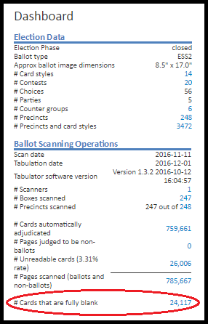
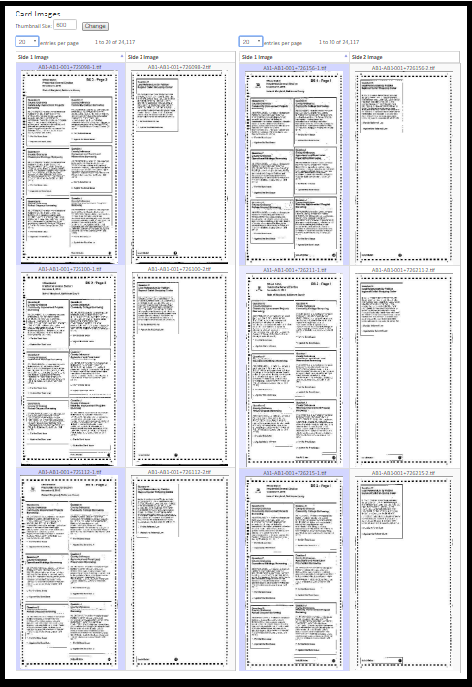
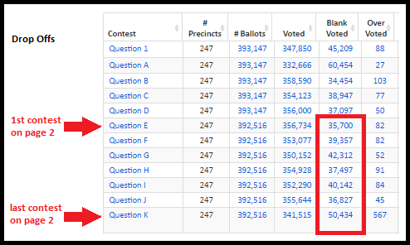
Why would voters show up to the polls and decide to cast blank ballots?
Notes:
The third question we received was…. There is a large number of blank ballots cast. Why would voters show up to the polls and decide to cast blank ballots?
To answer this question we used the ballot visualization tool to review all of the blank ballots and again were able to confirm that blank sheets were cast.

Slide 26
What else can an independent automated software audit identify?

Slide 27
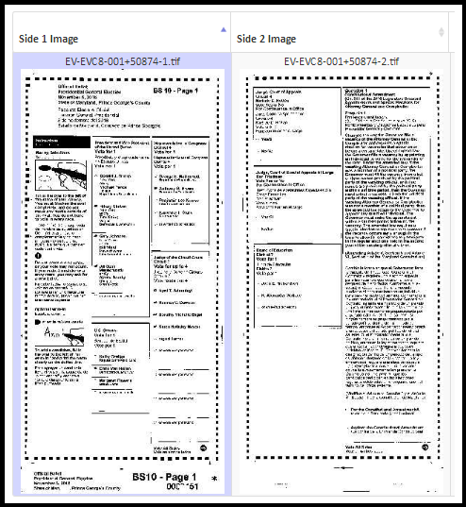
Identify voting locations where more poll worker training is needed
During the review of the unreadable ballot images, the vendor discovered that the stubs had been scanned. The stub should have been removed by the poll worker prior to scanning.
Notes:
This type of audit can help identify voting locations where additional poll worker training is necessary.
In this particular case, the poll worker scanned the ballot with the stub attached. The stub should have been removed prior to scanning. This was discovered by the vendor during the review of unreadable ballots.
12,144 regular ballots were unreadable out of the 4,529,685 ballots scanned = 0.26%
2,768 ExpressVote ballots were unreadable out of the 90,746 that were scanned = 3.0%

Slide 28
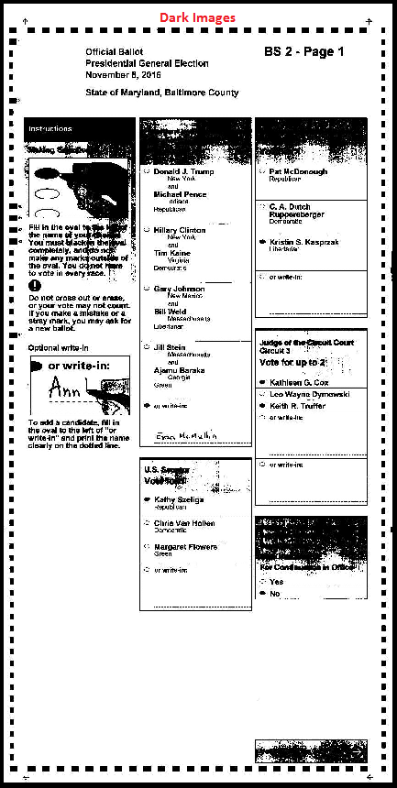
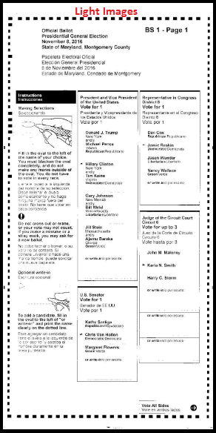
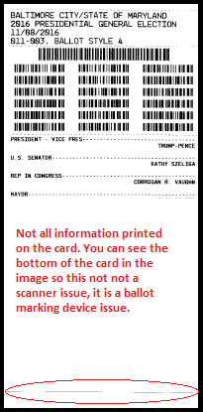
Identifying equipment issues
These issues were discovered during the review of unreadable ballots.
In all these cases, the voting system tabulated the ballots correctly.
Notes:
It can also help to identify equipment issues. The first image on the left is ballot printed on the ballot marking device. At first we thought this was an issue with the scanner and the way the image was captured. However, when we looked closer at the ballot image, we saw the bottom of the card and were able to identify that the issue was actually the printer on the ballot marking device.
The second and third image show issues with camera calibration on the scanners. One is incredible dark and the other really light. These issues can be detected and ultimately corrected by an automated software audit.
In all cases, the voting system tabulated the ballots correctly.

Slide 29
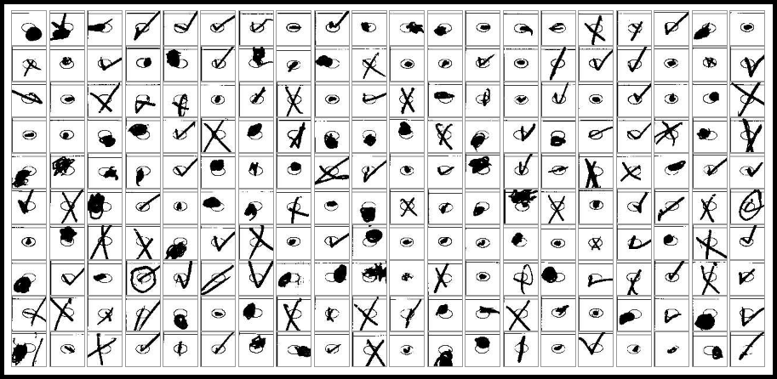
You can easily see the interesting ways that voters mark their ballots
Notes:
This was one of the most fascinating things for me to see. I really could have spent all day looking at them if Linda would have let me!

Slide 30
And…
Helps resolve recount issues or allows for more targeted recounts
Informs election administrators on issues with ballot design that lead to voter confusion (high percentage of voter error)
Assists election officials in evaluating how certain precincts are doing

Slide 31
It’s now 2018….
Legislature passed a law relating to ballot tabulation audits
After each primary & general election, we have to conduct an independent automated audit of ballot images
After each general election, we have to conduct a manual audit of voted ballots
2% of election day precincts
1% of ballots from early voting, absentee and provisional ballots
After a primary election, we may conduct a manual audit
The timing of the audits is important
Independent software audit must be done before certification.
Manual audit must be done 120 days after the election.
Notes:
House Bill 1278
Review requirements
Compromise – consideration to election administration concerns with manual audit before certification
Draft regulations
Review relevant provisions of draft regulations
Conditions for triggering a manual audit after primary election

Slide 32
2018 Primary Election
Used independent audit software to audit the results of the 2018 Primary Elections
http://maryland.clearballot.com/
Audit software verified the accuracy of the voting system’s results
Notes:
If Internet access, go to portal and show various reports for Baltimore City.
There are 3 reports that verify that the audit software counted the same number of ballots as the voting system
Comparison of Cards Cast report shows the two sets of totals at the contest level
Comparison of Votes Cast shows the two sets of totals at the precinct level
Comparison of Cards Cast by Counter Group report shows the two sets of totals at the “counter” level (early voting, election day, absentee 1, provisional, and absentee 2)
The two reports that are the “heart” of the audit are:
Comparison of Votes Cast report
See audit results by candidate
Clicking candidate total shows more details about the votes cast for that candidate.
Ovals are sorted by density and ranked from most to least confident.
Can see more of ballot image with that vote by hovering over the oval to see that vote or clicking the oval to see the complete ballot image
Contest Vote Discrepancy Report shows the difference – as a percentage – between the two sets of election results by contest and jurisdiction
Set 0.5% as the audit threshold
Results with a difference of 0.5% or less – no further action needed
Results with a difference of more than 0.5%, additional audit steps (e.g., hand counting voted ballots) would be required if the discrepancy can’t be explained
With these reports, we confirmed that the voting system accurately tabulated the ballots.
The audit results do not change the results of the elections.
It is a tool to identify where additional auditing may be necessary.
Use to prepare for recounts

Slide 33
What about the future?
Use the technology to analyze images from pre-election testing to identify issues with voting equipment before an election.
Develop way to detect ballot images that are too long to identify ballots scanned with stubs and “double pull” issues.
Integrate the voting system’s cast vote record to simplify process of comparing ballot level results.
Notes:
This would allow us to view the voting system and audit systems cast vote records side by side which would streamline our post election evaluation process. During this past general election, when the issues mentioned above were discovered, we had to locate the appropriate voting system cast vote record export (there could be up to 10 in the larger counties) and review them manually.
This is my last slide so I wanted to finish up by saying that this audit really was a game changer when it comes to our post election audits. Everything we needed was at our fingertips. Many of the issues that were identified might not have been discovered and most certainly not before certification deadlines.

Slide 34
Questions?
Nikki Charlson
Maryland State Board of Elections
nikki.charlson@maryland.gov
410.269.2843

